Slide 1



Information Communication Technology
(CSC101)
Lecture 8 and 9
Instructor: Mariam Fiaz
email: mariamsherwani434@gmail.com

Slide 2


Reference Books:
  Understanding Computers: Today and Tomorrow, Comprehensive – Deborah Morley & Charles S. Parker, Cengage Learning, 2017 (Read Chapters 16)
  Computer Science Illuminated – Nell Dale & John Lewis, Jones & Bartlett Learning, LLC, 2020 (Read Chapter 14)

Slide 3
Contents:
Intellectual Property Rights (IPR)
Ethics in ICT
Health Access and Environment
ICT Applications
  Health Industry
  Banking
  Expert Systems
  Digital Currencies
Cloud Computing
  Overview
  Advantages & Disadvantages
  Characteristics
  Service Models
  Deployment Models
  Security & Privacy
Internet of Things (IoT)
  Applications
  Characteristics
  Trends
Adoption Barriers

Slide 4
Intellectual Property Rights (IPR):
Intellectual Property Rights refer to the legal rights given to individuals or organizations to protect their creations and inventions.
These creations include:
• Software
• Digital content
• Designs
• Inventions
Types of IPR:
Copyright – protects written and digital content
Trademark – protects brand names and logos
Patent – protects inventions
Purpose: To prevent unauthorized copying or use of original work.

Slide 5
Ethics in ICT:
Ethics in ICT refers to the moral principles that guide the use of information and communication technology.
Important ethical issues include:
• Using software legally
• Respecting user privacy
• Avoiding hacking and cybercrime
• Not spreading false information
Ethical use of ICT ensures responsible and fair use of technology.

Slide 6
Health Access and Environment
ICT plays an important role in improving health services and environmental management.
Health Access:
• Online medical consultations (telemedicine)
• Electronic medical records
• Remote patient monitoring
2. Environment:
• Monitoring pollution levels
• Reducing paper usage through digital systems
• Smart energy systems

Slide 7
ICT Applications
ICT Applications are as follows:
Health Industry
ICT is used in hospitals and clinics to improve healthcare services.
Examples:
• Patient record systems
• Online appointments
• Diagnostic systems

Slide 8
ICT Applications
Banking
ICT has transformed banking services.
Examples:
• Online banking
• ATM systems
• Mobile banking apps
Benefits:
• Fast transactions
• 24/7 access

Slide 9
ICT Applications
3. Expert Systems
Expert systems are computer programs that simulate the decision-making ability of a human expert.
Examples:
• Medical diagnosis systems
• Technical support systems
They use knowledge and rules to solve problems.

Slide 10
ICT Applications
4. Digital Currencies
Digital currencies are electronic forms of money that exist only in digital form.
Examples:
• Cryptocurrencies
• Online payment tokens
Features:
• No physical form
• Fast transactions
• Global usage

Slide 11
Cloud Computing
Overview
Cloud computing is the delivery of computing services such as storage, software, and processing power over the internet.
Users can access data and applications without using local hardware.
Advantages
• Cost-effective (no need for expensive hardware)
• Easy access from anywhere
• Scalable (increase or decrease resources easily)
• Data backup and recovery

Slide 12
Cloud Computing
Dis-advantages
• Internet dependency
• Security risks
• Limited control over data
Characteristics
• On-demand self-service
• Broad network access
• Resource pooling
• Rapid elasticity
• Measured service

Slide 13
Service Models
There are three services models such as:
Infrastructure as a Service (IaaS):
Provides virtual hardware resources.
Platform as a Service (PaaS):
Provides a platform for developing applications.
Software as a Service (SaaS):
Provides software applications over the internet

Slide 14
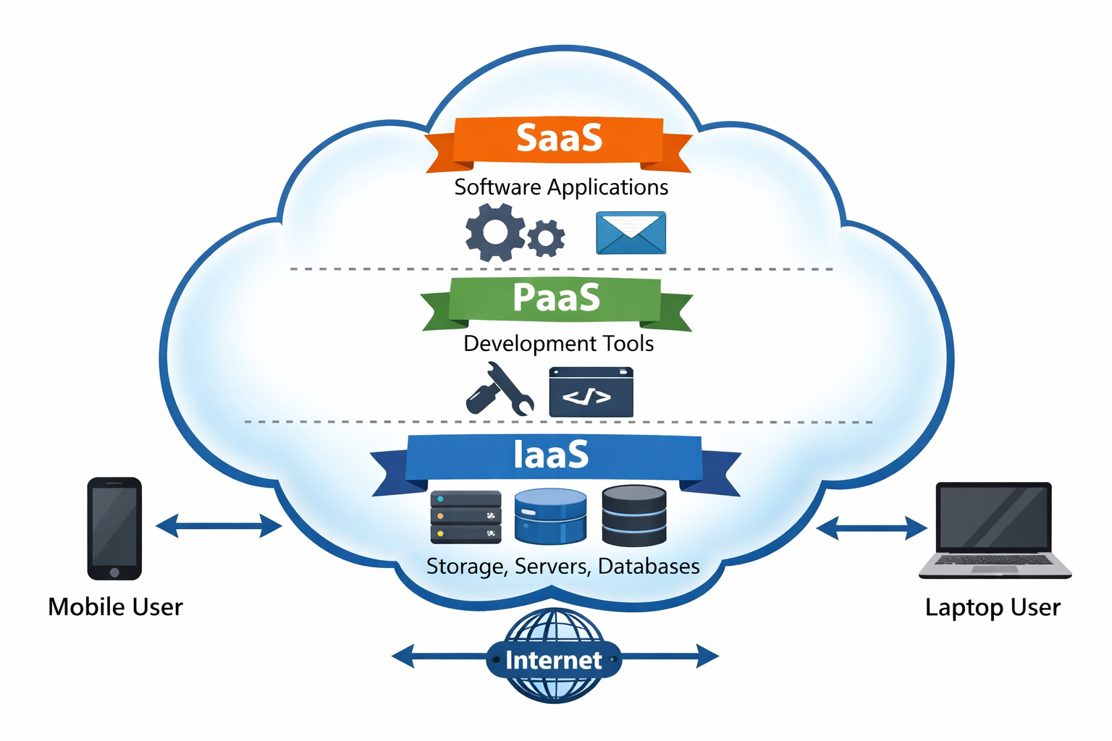

Slide 15
Deployment Models
There are three deployment models such as:
Public Cloud:
Available to the general public.
Private Cloud:
Used by a single organization.
Hybrid Cloud:
Combination of public and private cloud.

Slide 16
Security and Privacy of Cloud Computing
Cloud computing faces security challenges such as:
• Data breaches
• Unauthorized access
Protection methods include:
• Encryption
• Strong authentication
• Regular backups

Slide 17
Internet of Things (IoT)
Applications
IoT refers to connecting everyday devices to the internet.
Examples:
• Smart homes (smart lights, smart thermostats)
• Wearable devices (fitness trackers)
• Smart cities
• Industrial automation
Characteristics
• Connectivity • Real-time data collection
• Automation • Intelligence

Slide 18
Internet of Things (IoT)
3. Trends
• Growth of smart devices
• Increased use in healthcare and industries
• Integration with AI and big data
4. IoT Adaption Barriers
There are some challenges in adopting IoT:
• Security and privacy concerns
• High implementation cost
• Lack of standardization
• Technical complexity

Slide 19
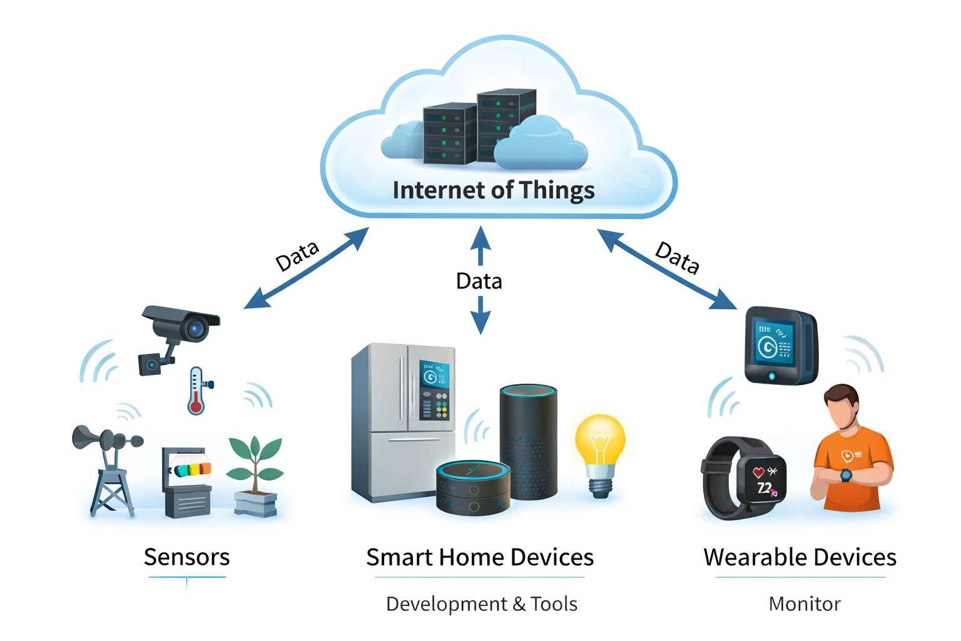

Slide 20
Summary of Lecture
ICT plays a major role in modern society through applications in healthcare, banking, and intelligent systems. Intellectual property and ethics ensure responsible use of technology. Cloud computing provides flexible and cost-effective computing solutions, while IoT connects devices to improve efficiency and automation. However, challenges such as security, privacy, and cost must be managed.

